Slide 1


Shield Insurance: Protecting India, One Policy at a Time
Shield Insurance is a leading provider in India. We focus on tailored solutions and prioritize customer needs. Our commitment is to provide security and peace of mind to our customers.
By Monis

Slide 2
Table of Contents
About Company
Shield Insurance.
Shield Insurance Dashboard
Comprehensive Insights for Risk Management and Policy Optimization.
Key Insights
Understand Trends to Improve Policies and Customer Experience.
Our Recommendations
Simple Steps to Improve Coverage and Satisfaction.

Slide 3
Company Overview: Shield Insurance
About Us
Our Mission
Founded in 2010
To provide reliable and accessible insurance solutions across India.
Headquartered in Mumbai, India
Employs over 500 insurance professionals

Slide 4
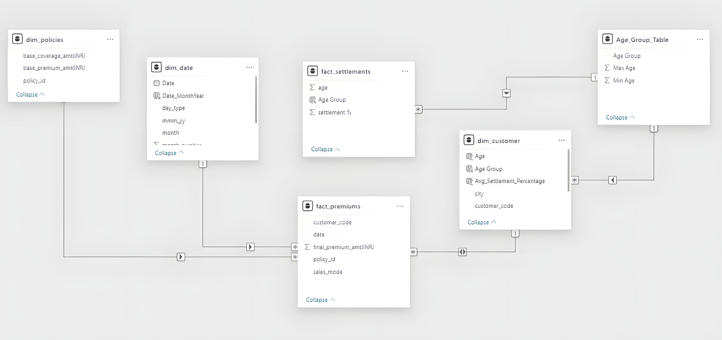
Data Model Overview
Fact Tables
fact_premiums
fact_settlements
Dimension Tables
dim_date
dim_customer
dim_policies
Relationships
The fact_premiums and fact_settlements tables are related
to the dim_customer, dim_policies, and dim_date tables.

Slide 5
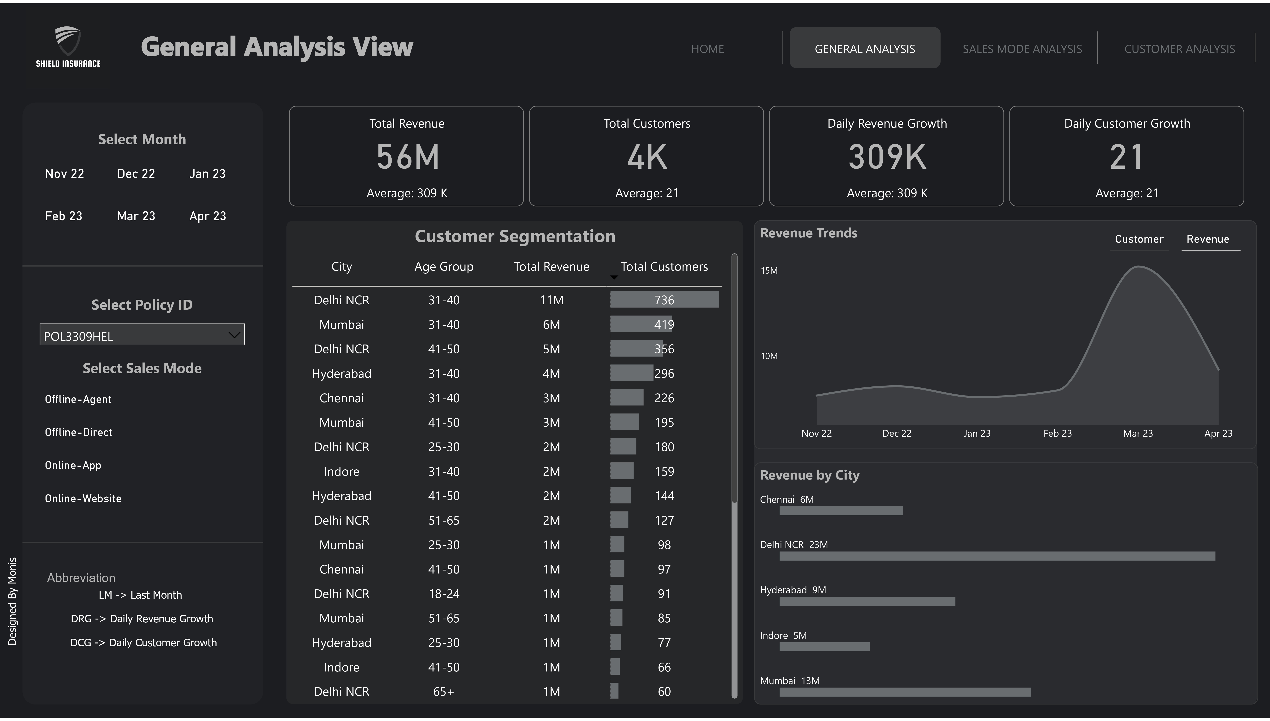

Slide 6
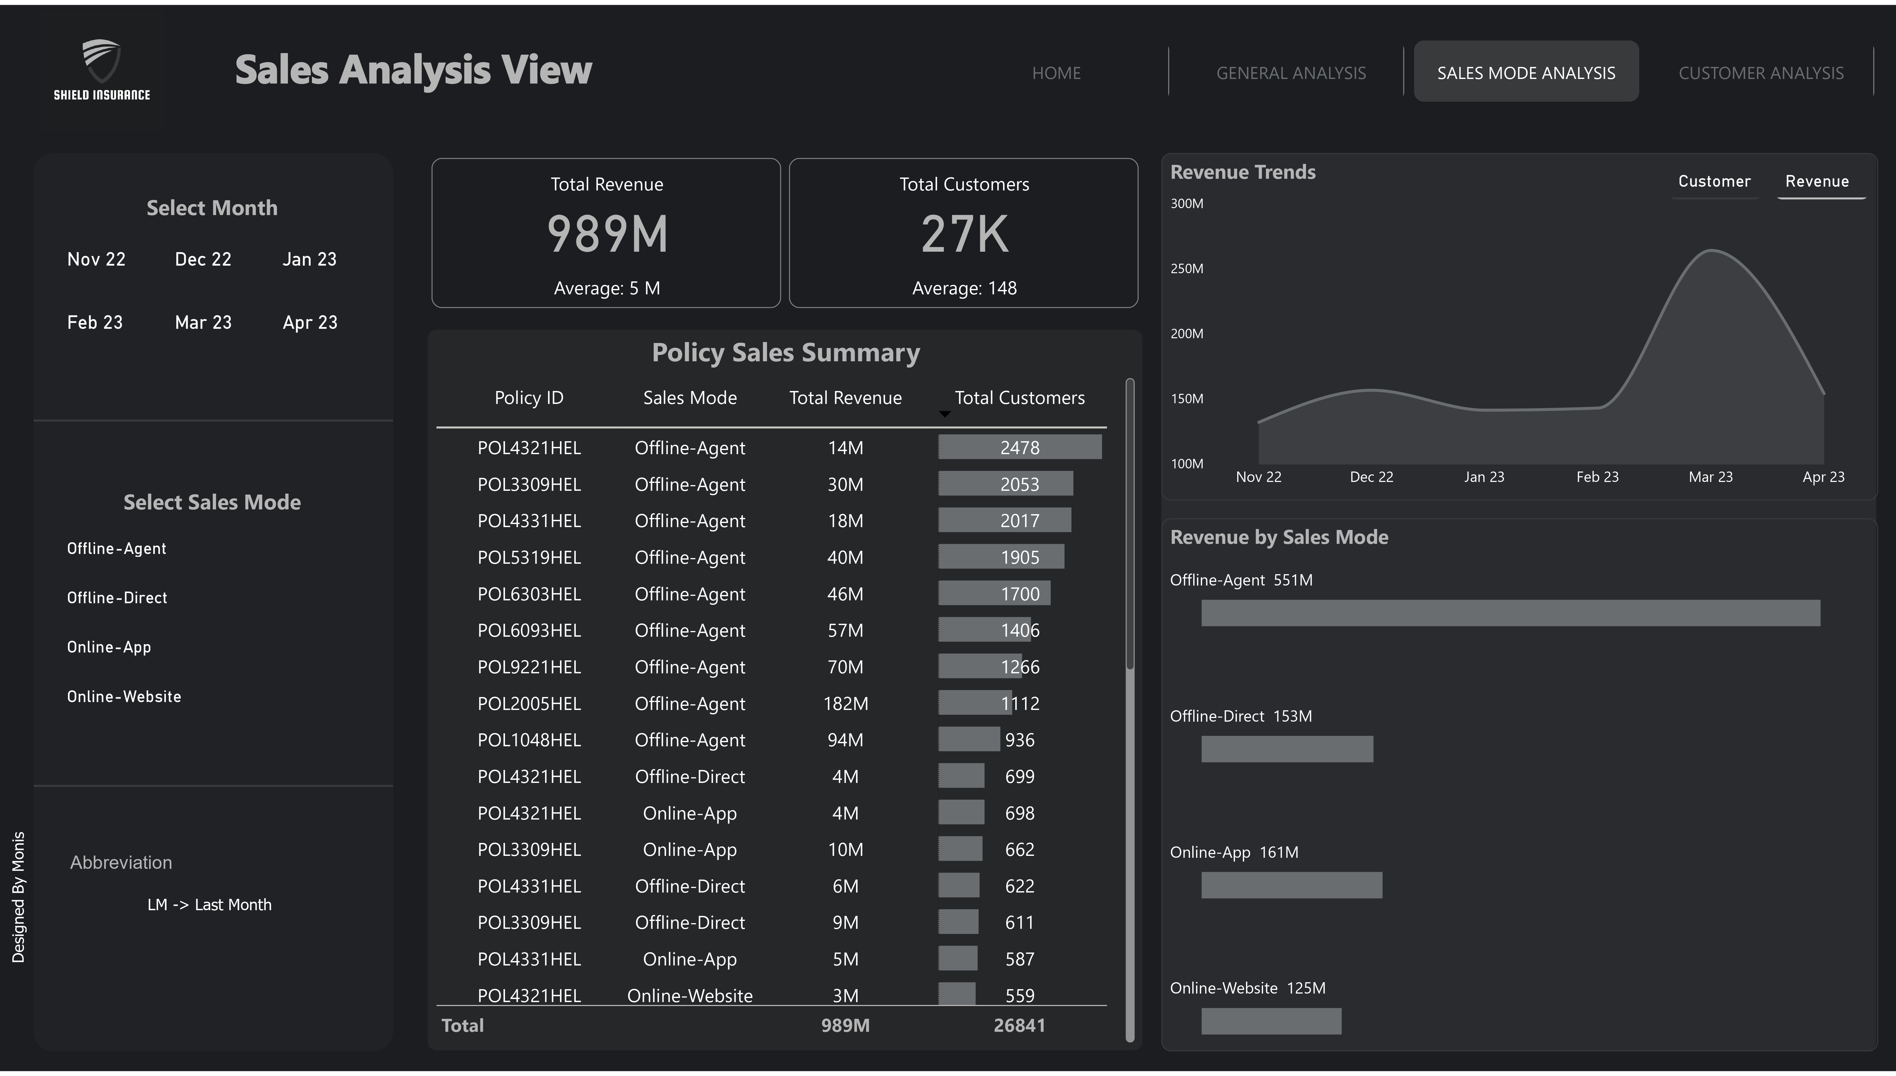

Slide 7
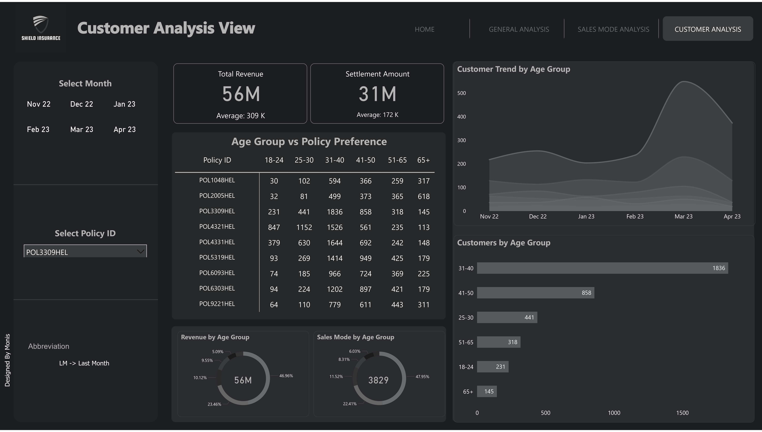

Slide 8
Key Insights
1. Business Performance:
Shield Insurance generated ₹989.25M in revenue from 26,841 customers.
We see a daily revenue growth of ₹5.47M and customer growth of 148.29.
2. Top Cities Driving Revenue:
Delhi NCR, Mumbai, and Hyderabad lead the way, contributing
over 80% of total revenue. Delhi NCR is at the forefront with ₹401.57M.
3. Customer Demographics:
The 31-40 age group is our highest revenue contributor at ₹335.72M,
followed by the 41-50 and 65+ age groups.
4. Sales Channels:
Offline channels dominate with ₹703.65M in revenue, especially
Offline-Agent sales at ₹550.8M. Online sales contribute ₹285.6M.
5. Customer Acquisition Trends:
March 2023 saw the highest customer acquisition, but new customer growth has slowed in the
following months, indicating seasonal fluctuations.

Slide 9




Recommendations
Enhance Digital Sales Strategies:
Target High-Value Age Groups:
Expand in High-Growth Cities:
Improve the mobile app experience
and offer exclusive online discounts to
boost online sales (currently ₹285.6M).
Focus on the 31-40 & 41-50 age
groups, which contribute 55% of revenue.
Tailor insurance plans for the growing
65+ segment (₹193.77M revenue).
Increase marketing efforts in Delhi NCR,
Mumbai, and Hyderabad, contributing
over 80% of revenue.

Slide 10
Thank You!
We Appreciate Your Time and Consideration.

